Slide 1
Zeolite Catalysts: A Numerical Analysis Approach for Raman
By Aldo Bushati

Slide 2
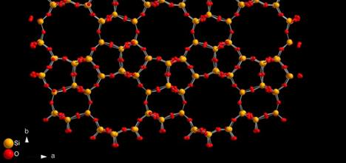
Introduction
Zeolites possess ordered structures facilitating selective adsorption and diffusion, key for shake-selective catalysts [1].
Numerical methods, including molecular modeling and Monte Carlo simulations, offer valuable insights into zeolite catalyst behavior [2].
Understanding active sites like cation exchange and acid sites in zeolite catalysts is pivotal for catalyst design and reaction mechanism comprehension [1].
Integrating experimental validation with computational predictions expedites novel zeolite catalyst development for industrial applications.
The molecular structure of ZSM-5 zeolite. Yellow balls represent Si and red balls represent O [3].

Slide 3
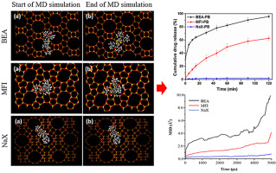
The Problem
The computational complexity of zeolite structures poses challenges in numerical methods.
Accurately representing the dynamic nature of zeolite catalysts in simulations remains a challenge within the community.
Validating numerical methods against experimental data is a challenge within the community.
Handling the intricacies of multi-step reaction mechanisms involved with zeolite catalysts requires advanced numerical methods.
Showcases the use of molecular dynamics (MD) in the field of zeolite catalysts. Through the use of MD they were able to show drug diffusion within the zeolite framework structure [4].

Slide 4
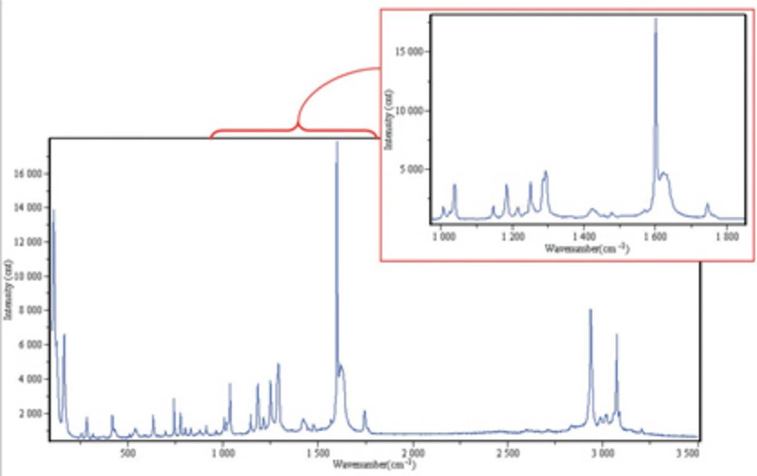
Background
Raman spectroscopy is a non-destructive chemical analysis technique which provides detailed information about chemical structure, phase and polymorphy, crystallinity, and molecular interactions [5].
Raman is a light scattering technique, where a molecule scatters incident light from a high intensity laser light source.
Most of the scattered light is at the same wavelength as the laser source and does not provide useful information- this is called Rayleigh Scatter.
However, a small amount of light is scattered at different wavelengths and this is called Raman scatter [5].
A typical Raman spectrum, in this case, of aspirin (4-acetylsalicylic acid) [5].

Slide 5
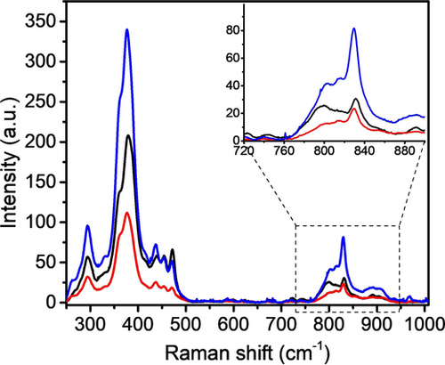
Background
Structural Insight: Raman probes zeolite catalysts, revealing their structure and activity, crucial for understanding catalytic mechanisms.
Molecular Dynamics: Helps understand reactions, diffusion, and adsorption-desorption processes at the molecular level.
Real-time Monitoring: Provides live data on active species, intermediates, and deactivation mechanisms, aiding optimization.
Quantitative Analysis: Determines active site concentrations, surface species, and catalyst loading for performance optimization.
Surface Chemistry: Reveals adsorption behavior, reactions, and catalyst poisoning, guiding modification.
Catalyst-Substrate Interaction: Uncovers factors influencing activity, selectivity, and stability for tailored designs [6].
Averaged Raman spectra of the zeolite P-ZSM-5 (black), MT-ZSM-5 (red), and ST-ZSM-5 (blue) crystals [7].

Slide 6
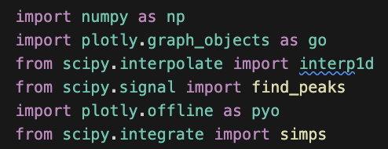
Approach
Importing Libraries:
Numpy – utilized in this code for numerical computations, array operations and mathematical calculations.
Plotly.graph_objects – used to create interactive plots for visualizing Raman spectra and catalyst activity data.
Scipy.interpolate – used to interpolate Raman spectra for smoother visualization for the viewer.
Scipy.signal - from this library ‘find_peaks’ is imported in order to detect peaks in Raman spectra that can then be annotated.
Plotly.offline – ‘plotly.offline’ is used to generate and save interactive plots of Raman spectra and catalyst activity.
Scipy.integrate – ‘simps’ is used to calculate the area under peaks in the Raman spectra.
Showcases some of the charts that can be made using Plotly in Python [8].

Slide 7
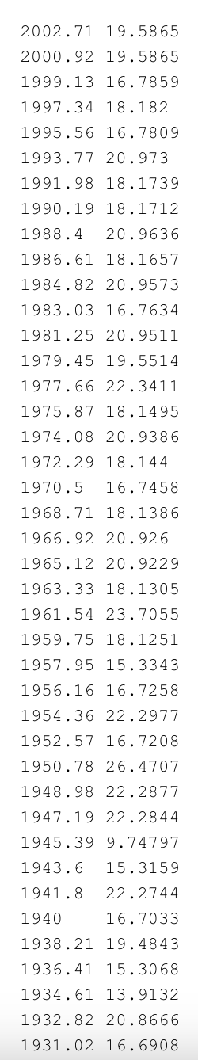
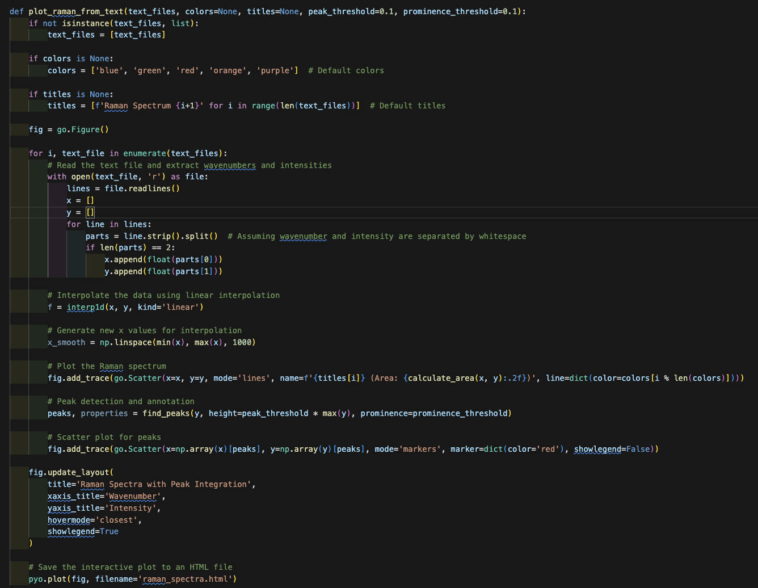
Approach
Function 1: plot_raman_from_text
Input Paramters
’Text_files’ – files that contain Raman spectra data.
‘Colors’ – optional list of colors for plotting each spectra.
‘titles’ - title for each Raman spectrum.
‘peak threshold’ – threshold for peak detection based on relative intensity.
‘prominence_threshold’ - threshold for peak detection based on promience.
Function reads each text file provided in the ‘text_files’ list and extracts wavenumbers and intensity. Assumes that the two are separated by whitespace.
Linear interpolation is performed on the extracted data using ‘interp1d’ from ‘scipy.interpolate’.
Raw text file for the Raman data

Slide 8
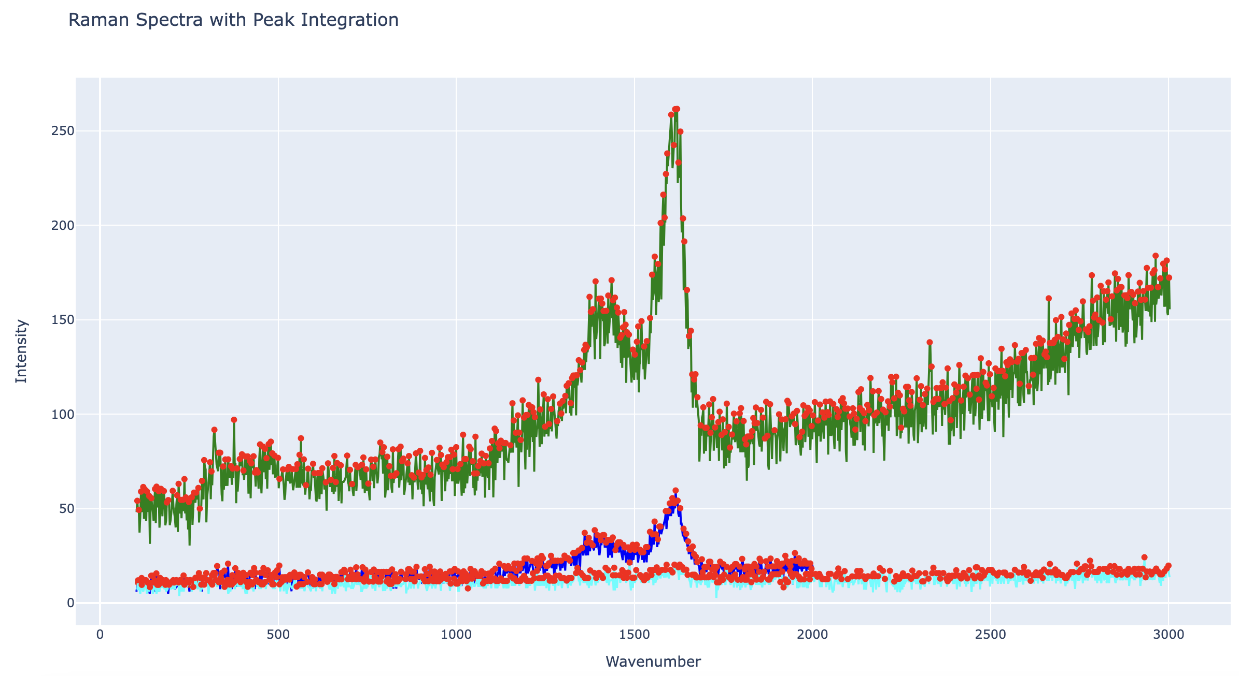
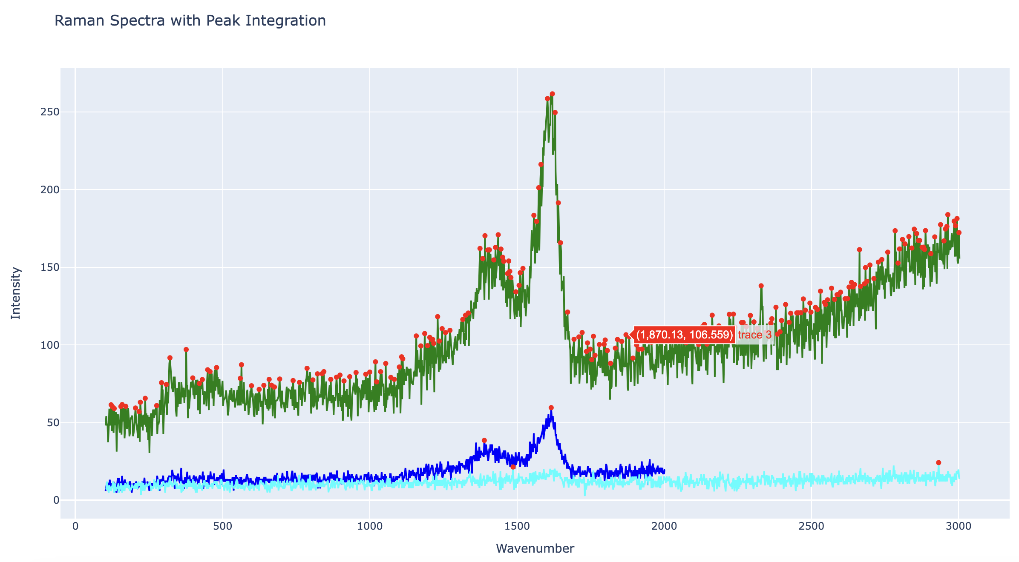
Approach
Function 1: plot_raman_from text
The interpolated data is plotted as Raman spectra using ‘plotly.graph_objects.Scatter’
Each spectrum is plotted as a lineplot with wavenumbers on the x-axis and intensities on the y-axis.
Peaks in the Raman spectra are spotted through using ‘find_peaks’ from ‘scipy.signal’
Detected peaks are annoted with red markers using ‘plotly.graph_objects.Scatter’
Layout of the plot is configured using ‘update_layout’ to set the title, x-axis and y-axis label, and the hover mode.
The interactive plot is saved to an HTML file using ‘plotly.offline.plot’.
Allows for viewing the plot in a web browser without the need for internet.
Raman_spectrum.html with prominence threshold of 1
Raman_spectrum.html with prominence threshold of 15

Slide 9
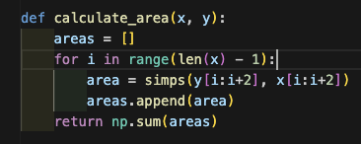
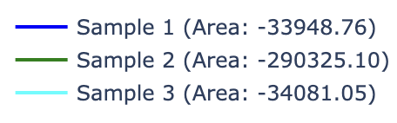
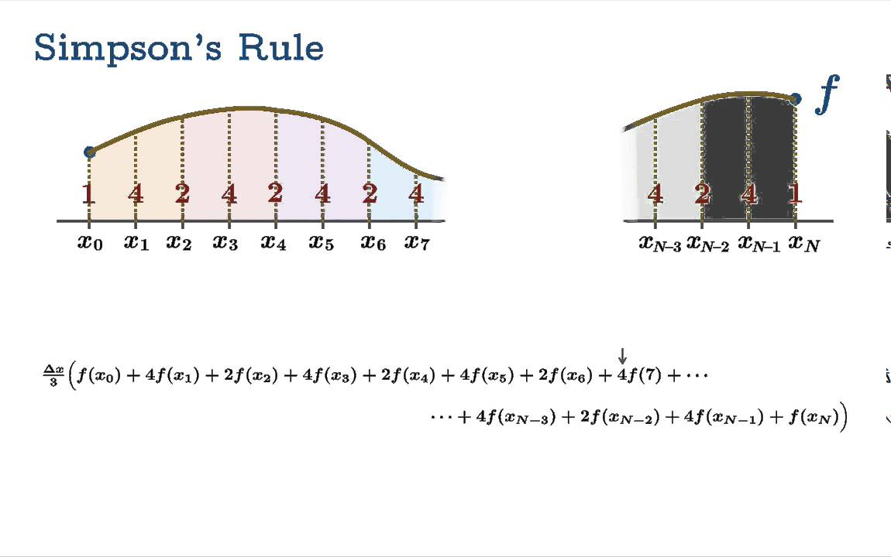
Approach
Function 2: calculate_area
Function takes two input parameters:
‘x’ – a list of array containing the independent variable (e.g., wavenumbers)
‘y’ – a list of array containing the dependent variable (e.g., intensities)
The function iterates over the provided data points (x,y) to calculate the area under each peak.
Area under each peak is computed using the Simpson’s rule.
The function iterates over the data points in a loop, considering adjacent pairs of points.
For each pair of adjacent points, it calculates the area under the curve segment and then adds up all of the individual area to obtain the total area under the curve.
The function returns the sum of all calculated areas, depending how many spectrums are put in the function, in the legend section.
Different peaks correspond to vibrations within the framework structure of the zeolite. Changes in peak area can indicate structural changes or framework defects [10].
Displays Simpson’s rule and how it works [9].

Slide 10
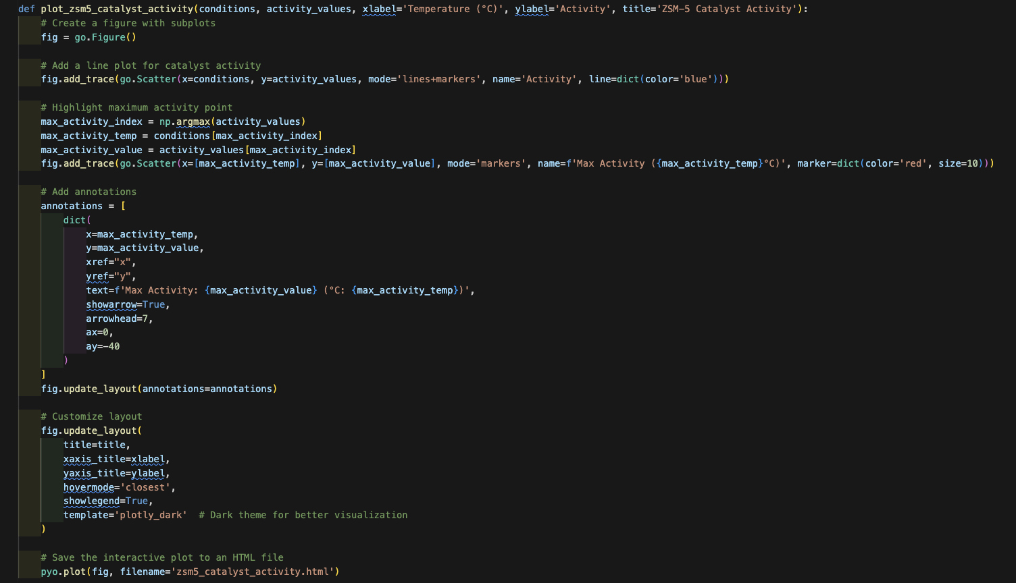
Approach
Function 3: plot_zsm5_catalyst_activity
Input paramters:
‘conditions’ – values representing the experimental conditions in this case temperature.
‘conversion_values’ – values representing the conversion values at each condition.
‘xlabel’, ’ylabel’, ’title’ – parameters to customize the labels and title of the plot.
Create a new figure using ‘go.Figure()’ from Plotly.
We add a line plot to the figure using ‘fig.add_trace(go.Scatter())’
The line plot represents the conversion values as a function of experimental conditions.
Identify the index of maximum conversion value using ‘np.armax(conversion_value)’
Add a scatter plot point at the maximum conversion point using ‘fig.add_trace(go.Scatter())’.
Highlighted in red so users can see the maximum conversion. Useful when there a lot of data points.

Slide 11
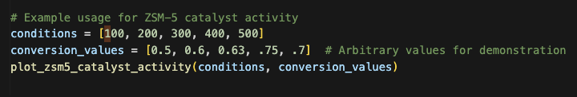
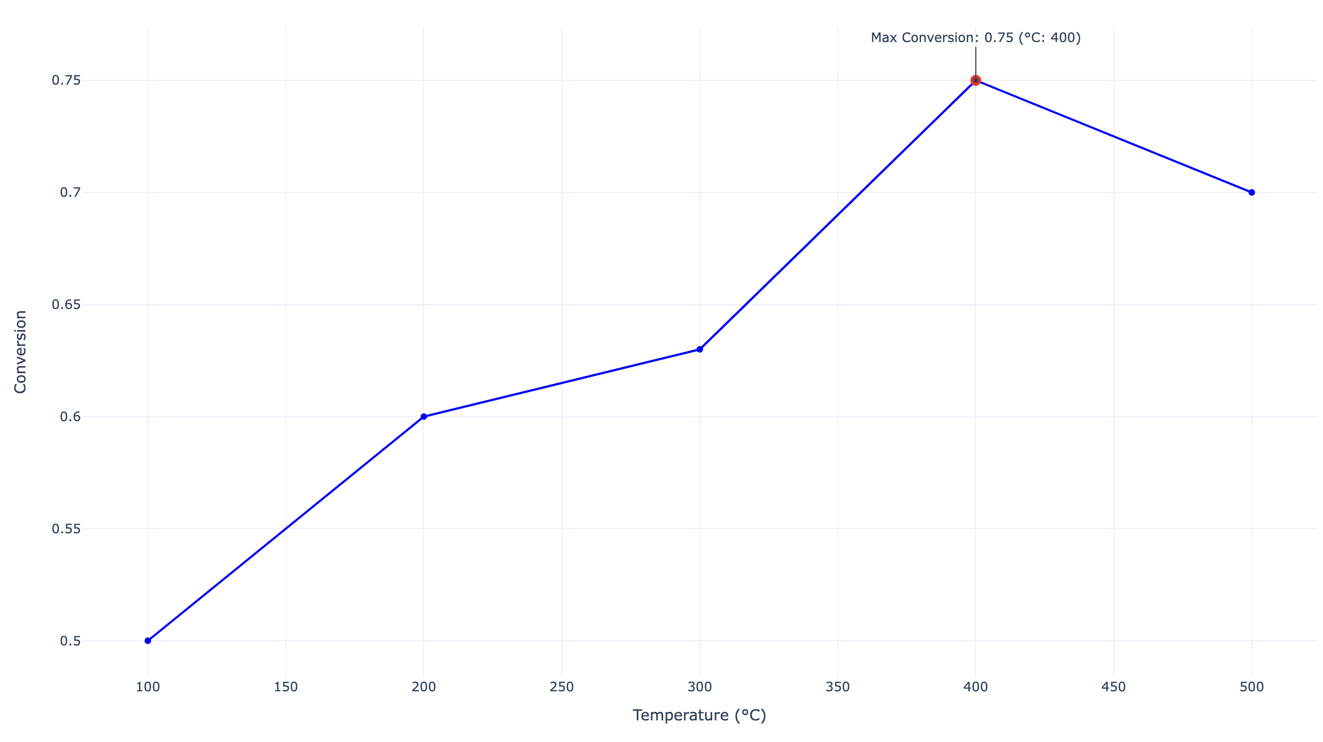
Approach
Function 3: plot_zsm5_catalyst_activity
Create an annotation to display the maximum conversion value and corresponding temperature.
The point is placed on the max conversion using ‘fig.update_layout(annotations=[])’
Update the layout of the plot with the title, x- and y- label, and hover mode using ‘fig.update_layout()’
‘plotly_white’ sets the template to a white theme for better visualization.
Save the interactive plot to an HTML file using ‘pyo.plot()’
Allows for viewing the plot in a web browser.
The graph becomes more useful when you are dealing with multiple data points. In this case, we are only dealing with 5.

Slide 12
Results and Discussion
Raman spectroscopy serves as a powerful tool to characterize structural integrity, framework distortions, and adsorbate interactions within ZSM-5 catalysts, offering crucial insights into their catalytic performance and stability [10].
The code provides visual representations, aiding in the qualitative assessment of the ZSM catalyst's crystallinity and sensitivity to synthesis conditions.
These visuals allow researchers to quickly grasp the catalyst's characteristics and optimize synthesis parameters for improved performance.

Slide 13
Conclusion and Future Work
Conclusion:
Raman spectroscopy provided crucial insights into ZSM-5 catalyst structural properties and composition.
Identifying molecular vibrations with Raman enhanced understanding of catalyst structural integrity and surface interactions.
Integration of Raman spectroscopy enriched understanding of ZSM-5 catalyst properties and performance.
Highlighted maximum conversion points, aiding in the identification of optimal operating conditions for catalyst synthesis.
Future Work:
Utilize advanced machine learning techniques such as neural networks or support vector machines to develop predictive models for catalytic performance.
Integrate Raman spectroscopy with other techniques like SEM and TEM for a comprehensive catalyst understanding.
Investigate synergies between catalyst materials and synthesis strategies to design hybrid catalyst systems for improved performance.
Partner with industry to scale up optimized synthesis protocols and assess catalyst performance under real-world conditions.

Slide 14
References
[1] Manda, Timothy, et al. “A Data Guided Approach for the Evaluation of Zeolites for Hydrogen Storage With the Aid of Molecular Simulations.” Research Square (Research Square), July 2023, doi:10.21203/rs.3.rs-3141446/v1.
[2] Formalik, Filip, et al. “Exploring the Structural, Dynamic, and Functional Properties of Metal‐Organic Frameworks Through Molecular Modeling.” Advanced Functional Materials, Oct. 2023, doi:10.1002/adfm.202308130.
[3] ISIS Looking Inside a Zeolite to Understand Its Catalytic Selectivity. www.isis.stfc.ac.uk/Pages/SH19_Looking-inside-a-zeolite.aspx.
[4] Karavasili, Christina, et al. “Experimental and Molecular Dynamics Simulation Studies of an Anti-hyperlipidemic Drug Release From Microporous Zeolites Differing in Si/Al Content.” Microporous and Mesoporous Materials, vol. 305, Oct. 2020, p. 110343, doi:10.1016/j.micromeso.2020.110343.
[5] What Is Raman Spectroscopy? - HORIBA. www.horiba.com/int/scientific/technologies/raman-imaging-and-spectroscopy/raman-spectroscopy.
[6] Cheng, Qian, et al. “Emerging Applications of Stimulated Raman Scattering Microscopy in Materials Science.” Matter, vol. 4, no. 5, May 2021, pp. 1460–83, doi:10.1016/j.matt.2021.02.013.
[7] Attila, Özgün, et al. “3D Raman Spectroscopy of Large Zeolite ZSM‐5 Crystals.” Chemistry, vol. 25, no. 29, May 2019, pp. 7158–67, doi:10.1002/chem.201805664.
[8] Plotly. “Plotly.py 4.0 Is Here: Offline Only, Express First, Displayable Anywhere.” Medium, 11 Dec. 2021, medium.com/plotly/plotly-py-4-0-is-here-offline-only-express-first-displayable-anywhere-fc444e5659ee.
[9] Chris Odden. “Simpson’s Rule.” YouTube, 4 Jan. 2016, www.youtube.com/watch?v=oYHaKSvtTy0.
[10] Hadjiivanov, K. I., Panayotov, D. A., Mihaylov, M. Y., Ivanova, E. Z., Chakarova, K. K., Andonova, S. M., & Drenchev, N. L. (2020). Power of Infrared and Raman Spectroscopies to Characterize Metal-Organic Frameworks and Investigate Their Interaction with Guest Molecules. Chemical Reviews. doi:10.1021/acs.chemrev.0c00487

